Slide 1

IBM Cloud Pak for AIOps
Firstname Lastname
Job Title
email.address@ibm.com
123.456.7890

Slide 2
Please note
IBM’s statements regarding its plans, directions, and intent are subject to change or withdrawal without notice and at IBM’s sole discretion.
Information regarding potential future products is intended to outline our general product direction and it should not be relied on in making a purchasing decision.
The information mentioned regarding potential future products is not a commitment, promise, or legal obligation to deliver any material, code or functionality. Information about potential future products may not be incorporated into any contract.
The development, release, and timing of any future features or functionality described for our products remains at our sole discretion.
Performance is based on measurements and projections using standard IBM benchmarks in a controlled environment. The actual throughput or performance that any user will experience will vary depending upon many factors, including considerations such as the amount of multiprogramming in the user’s job stream, the I/O configuration, the storage configuration, and the workload processed. Therefore, no assurance can be given that an individual user will achieve results similar to those stated here.
IBM Automation / © 2023 IBM Corporation
2

Slide 3



IT Operations are the backbone of your business operations
To enable successful business outcomes and customer experiences in a digital world IT must be…
Highly available and responsive Applications, networks, and infrastructure
Agile and scalable
Resilient operations aligned with business speed and pace
Cost effective and sustainable
Optimized to avoid the financial and environmental costs of overprovisioning
IBM Automation / © 2023 IBM Corporation
Notes:
Business performance = IT Performance (The opportunity)
In today's digitally transformed world, IT operations are the backbone of business operations.
To enable successful business outcomes and customer experiences in a digital world, IT must be:
- Highly available and responsive – across applications, networks, and infrastructure
- Agile and scalable – resilient operations need to be aligned with modern business speed and pace
- And cost effective and sustainable – IT has to be optimized to avoid the financial and environmental costs of overprovisioning

Slide 4
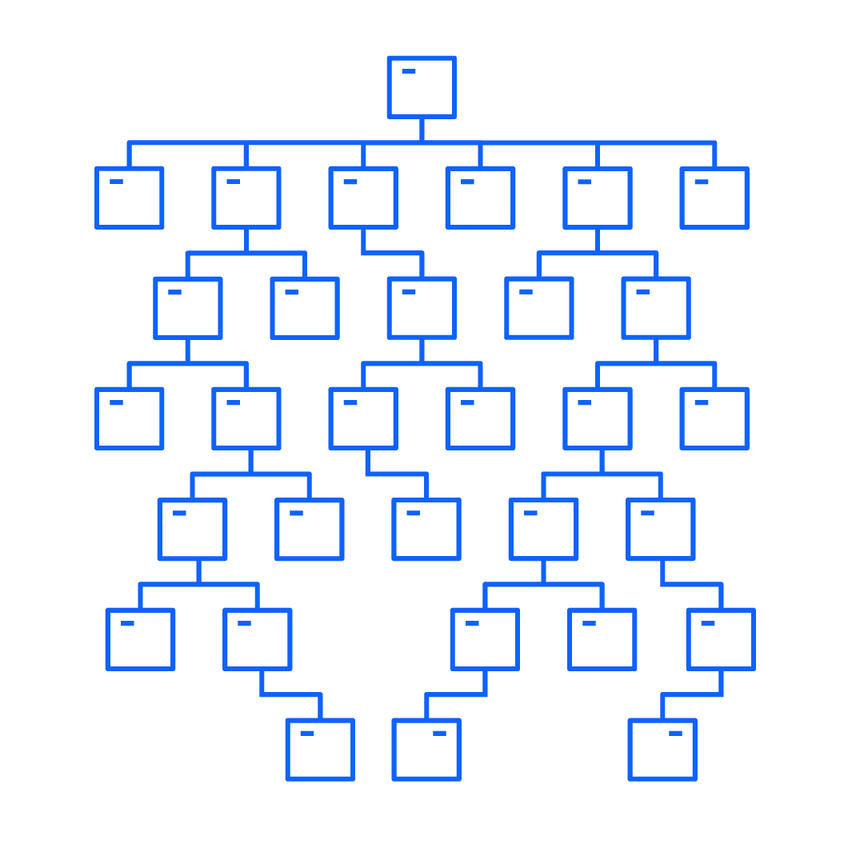
Deployment options present an opportunity, but add complexity
There’s too much data for people
As of 2023, organizations are using an average of over 1,000 applications across multiple clouds
Current break-fix, reactive approaches cannot scale
Existing piecemeal tools result in inconsistencies and inefficiencies, undermining effectiveness and long-term viability
Businesses need real-time visibility to leverage actionable insights to enhance overall IT operations
IBM Automation / © 2023 IBM Corporation
Notes:
Deployment options presents an opportunity, but add complexity (The challenge: hybrid cloud)
Companies have turned to hybrid cloud to deliver those unique end-user experiences, with 76% of companies using 2 or more public clouds. But managing the distributed nature of applications across multiple clouds with limited talent resources is increasingly difficult.
The growing complexity of IT systems, driven by the sheer volume of applications and infrastructure, coupled with the deployment decisions on offer regarding virtual machines, bare metal, and cloud-native deployments like containers and pods, contributes to this complexity.
And most companies have hundreds, if not thousands, of applications spread across numerous clouds and networks, making it difficult to get a comprehensive view of IT assets and systems, as well as manage them. As of this year, 2023, organizations are using on average over 1,000 applications across clouds.
More than a person can handle (Why the status quo doesn’t work)
What we see from all of this is that there’s simply more data being generated than can be absorbed by a person, let alone have them interpret and make complex decisions based on that data.
Current, “break-fix” IT operations management approaches simply cannot keep up with the demands of modern business.
And piecemeal software solutions aren't sustainable, and result in inconsistencies and inefficiencies that undermine the effectiveness of those solutions and their long-term viability.
I.E. Purchasing additional software to address performance issues rather than optimizing existing resources; Updating software versions individually, without considering the impact on the entire IT ecosystem; Implementing point solutions for specific business needs without considering the integration of the solution with existing systems and processes.
Enterprises need applications and services to deliver consistent and continuous performance that is compliant, cost-effective, and adaptive to change.
To achieve this, businesses need real-time visibility into their infrastructure and application estates to leverage actionable insights to automate and enhance overall IT operations – which they are not seeing today.
76% stat: https://www.oracle.com/a/ocom/docs/cloud/oracle-451-research-advisory-blog-adopting.pdf
Application growth continues with organizations using an average of 1,061 different applications in 2023. Source: Mulesoft + Deloitte 2023 Report: https://resources.mulesoft.com/ty-report-connectivity-benchmark.html#loaded

Slide 5
IT incidents are an unfortunate expensive reality of digitally enabled enterprises
Over the last three years…
94% of enterprises experienced an IT outage
97% of enterprises experienced a slowdown of IT services
On average enterprises experience 15 outages per year
91% of enterprises report downtime costs exceed $300,000 per hour
IBM Automation / © 2023 IBM Corporation
Notes:
https://queue-it.com/blog/cost-of-downtime/
https://itic-corp.com/itic-2021-global-server-hardware-server-os-reliability-survey-results/
https://www.logicmonitor.com/it-downtime-mitigation-report

Slide 6
Current methods of resolving incidents are slow and reactive
Siloed Monitoring Tools
On average, enterprises use 9 or more different monitoring tools that do not speak to each other leading to no federation of intelligence across tools
IT organizations spend an average of 40% of their time on manual, repetitive tasks related to monitoring and incident response
Traditional monitoring solutions only provide visibility into an organization's systems after an incident has already occurred
Slow Incident Response Times
Inefficient Manual Processes
Lack of Proactive Monitoring
IBM Automation / © 2023 IBM Corporation
Notes:
https://queue-it.com/blog/cost-of-downtime/
https://itic-corp.com/itic-2021-global-server-hardware-server-os-reliability-survey-results/
https://www.logicmonitor.com/it-downtime-mitigation-report

Slide 7
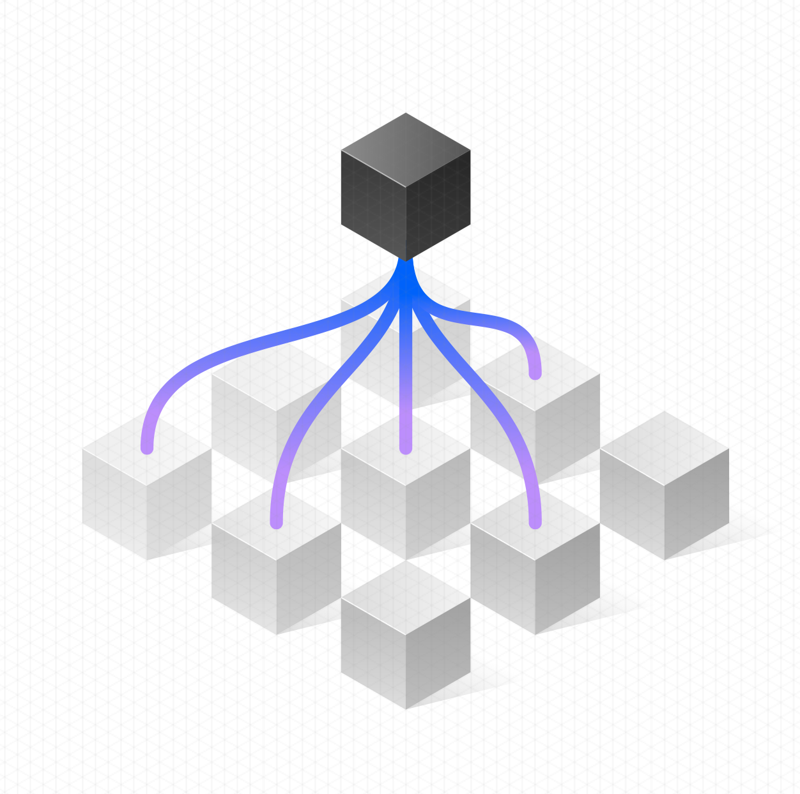
AIOps is the answer…
Deliver 24/7, 365 performance and assurance with AIOps
AIOps is a discipline that combines software solutions and cultural practices to help IT Operations teams overcome these mounting challenges by:
Breaking down data silos
Providing real-time insights into IT systems
Augmenting incident management with AI
Automating incident resolution
IBM Automation / © 2023 IBM Corporation
Notes:
How do you address these challenges (The way forward)
And to achieve this, businesses must use AI-powered automation to create IT that can respond in seconds
IT modernization is necessary to achieve this and AIOps offers a way forward by providing real-time visibility into infrastructure and leveraging high-impact automations to enhance overall IT ops, all while reducing manual effort and human error.
97% of IT professionals believe that AI applied IT Operations will deliver actionable insights to help automate and enhance overall IT operations functions.
With AIOps, enterprises can deliver 24/7, 365 performance and assurance and help IT teams be one step ahead of all end-user issues, moving from being reactive to predictive.
AIOps offers federated data across existing tools and out of the box insights to meet teams where they work, reducing maintenance and the contractual overhead of having multiple tools by de-risking consolidation over time.
With AIOps, businesses can achieve proactive, continuous, connected, and optimized IT performance and assurance.
97% stat: https://www.aims.ai/aiops-building-blocks

Slide 8
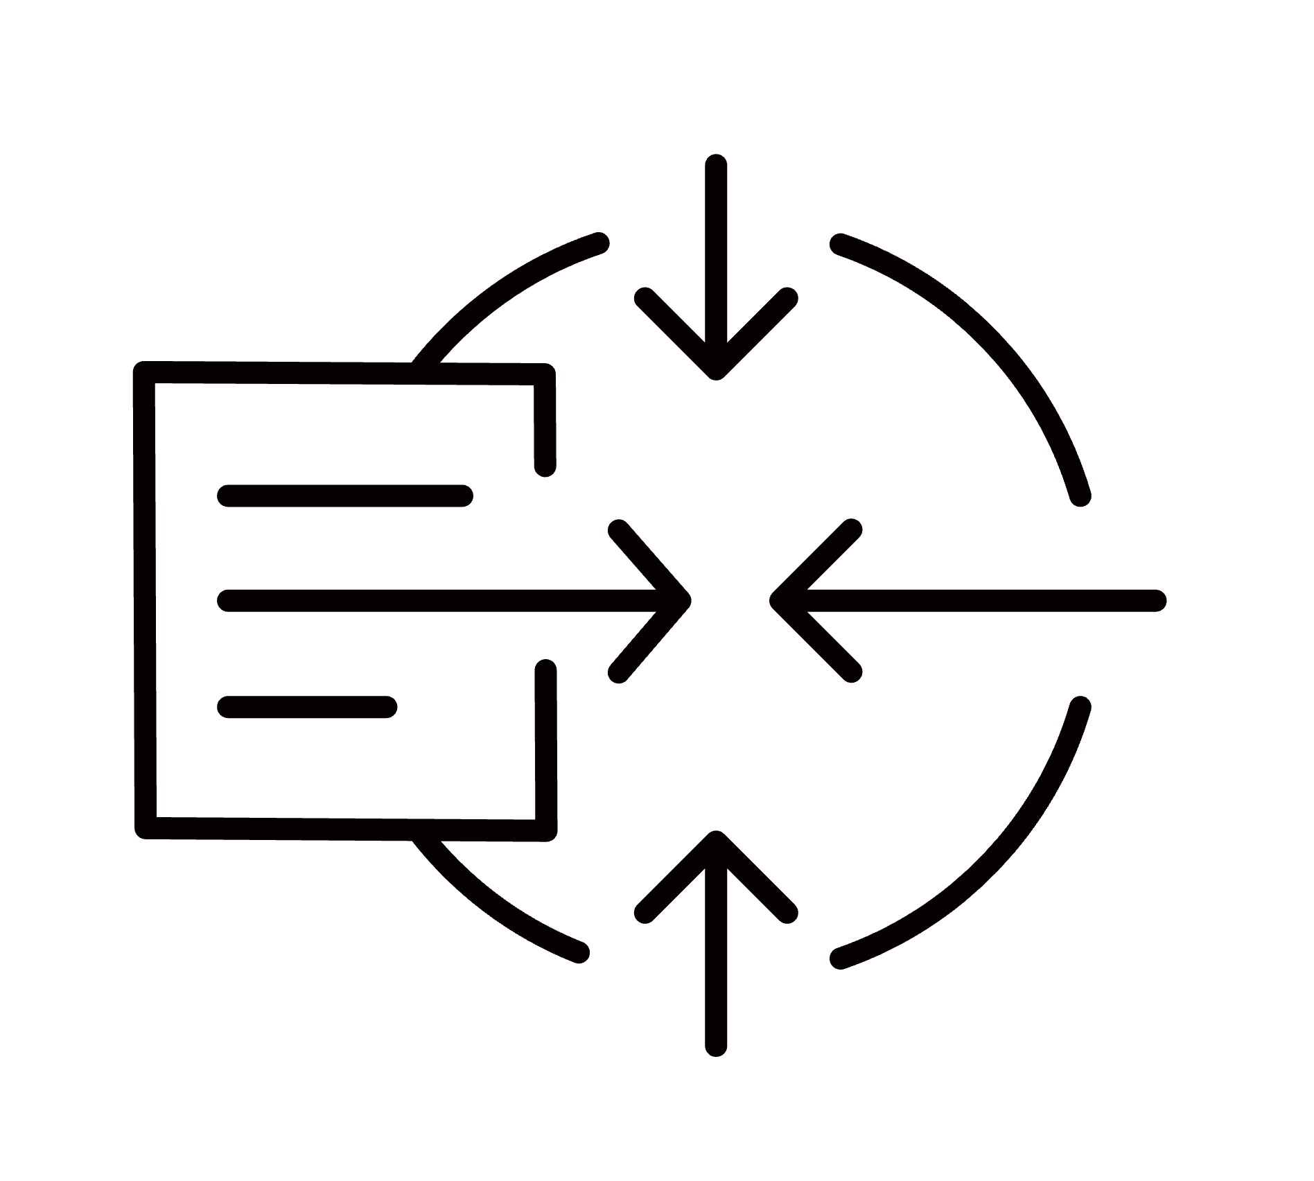

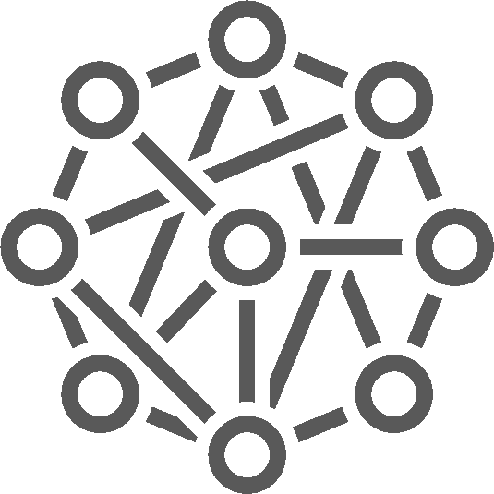





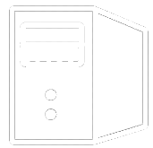




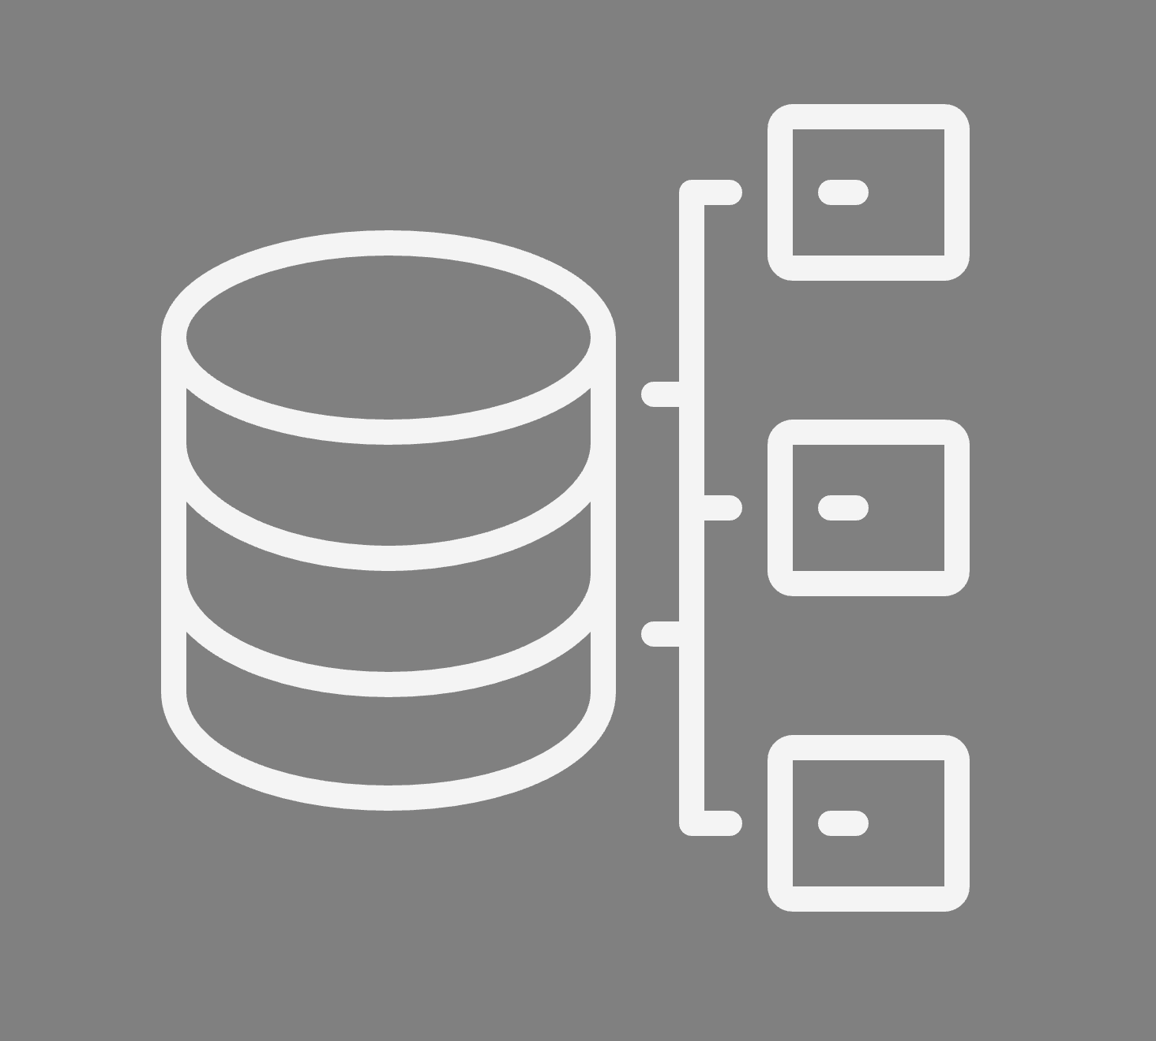






Intelligent IT Automation with IBM AIOps The most complete and integrated set of modular automation technologies
AI-powered IT Operations
Enterprise Observability
Automated Operations
Incident Management
Enhance visibility and comprehension with full stack scalable application and network health and performance monitoring
Dynamically and continuously assure cost effective application performance and resource utilization
Automate and orchestrate end-to-end IT and network operations at scale with efficiency and resiliency
Data Collection
Enterprise Observability
Cost-effective Resource Management
Network Performance Management
AI and ML
Proactive Incident Resolution
Instana
SevOne
Turbonomic
Cloud Pak for AIOps
IBM Automation / © IBM Corporation 2023
Platforms
Hybrid Multicloud Networks
Data
IBM Automation / © 2023 IBM Corporation
Notes:
IBM offers Intelligent IT Automation with IBM AIOps
We have developed the most complete set of IT automation and AIOps management tools in the industry that operate across your entire hybrid multicloud estate, and control all of your IT components. Our holistic approach places application uptime and performance at the center of focus, driving lifecycle automation with AI for all tasks needed to provision and manage IT systems on a day-to-day basis.
IBM AIOps delivers this by providing:
Enterprise Observability
Automated Operations
And Incident Management
Leveraging these three pillars of IBM’s AIOps solutions, organizations can better predict incidents and identify and execute high-impact automations across business and IT using proven tools and insights to quickly get to better business outcomes.

Slide 9
Incident Management with IBM AIOps Platform The most advanced incident management platform to resolve incidents quickly and keep businesses running smoothly
IBM AIOps Platform
Automate and orchestrate end-to-end IT and network operations at scale with efficiency and resiliency
Cloud Pak for AIOps (self-hosted)
Data Aggregation and Noise Reduction
Incident Triage
Incident Remediation
Over 100 connectors and up to 99% noise reduction
Reduce time to detect (TTD) by 70% by quickly understanding what went wrong
50% reduction in outages and up to 95% reduction in mean time to recovery,
IBM Automation / © 2023 IBM Corporation
Notes:
Here we better define the relationship between incident management as a practice and AIOps platforms as a set of solutions that identify meaningful patterns within the data and provide actionable insights to support proactive responses.
AIOps platforms leverage telemetry and event analysis, along with advanced technologies, to enhance incident management processes. They empower organizations to automate incident detection, perform effective root cause analysis, proactively respond to incidents, prioritize them efficiently, and improve incident resolution efficiency, ultimately enabling end-to-end IT and network operations at scale with efficiency and resiliency.
3 Use Cases of IBM’s AIOps Platform:
Data Aggregation & Noise Reduction
Incident Triage
Incident Remediation
Emphasize how AIOps platforms enhance and optimize the efficiency, resilience, and scalability of incident management processes.

Slide 10
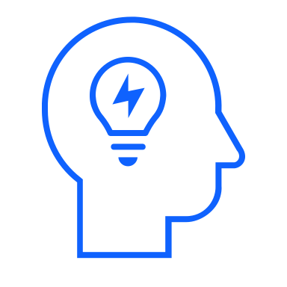



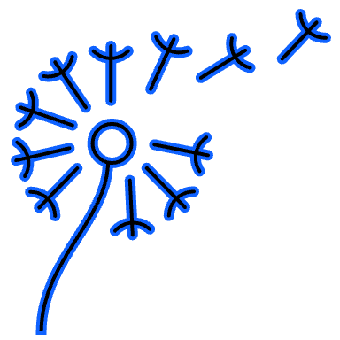
IBM Cloud Pak for AIOps: Use Cases
Leverage AI to streamline IT operations, increase uptime, improve efficiency and reduce costs​
Data Ingestion & Integration
Streamline, Connect, Analyze
Simplify data configuration and leverage automation tools for connecting to various systems, ingesting, and analyzing data from multiple domains, tools, and sources in real-time or historically.
Topology Generation
Unify, Visualize, & Pinpoint Incidents
Gain control over dynamic infrastructure, enabling periodic assembly of unified IT asset topologies, providing visibility into applications and resources for effective incident pinpointing.
Event Correlation & Compression Correlate, Compress & Visualize Events
Reduce event overload with event correlation and compression, leveraging event analytics to group, enrich, suppress, and visualize events based on user-defined attributes, using time, topology, and behavior patterns for efficient incident management.
Incident Recognition AI-Driven Clustering & Visualization
Reduce MTTR by leveraging multiple AI models for incident understanding and diagnosis. Use unsupervised training and user-friendly model management tools. Visualize correlated incident alerts, metrics, topology, and recommended runbooks in a centralized console. Integrate ChatOps for seamless communication and coordination with team members.
Augmented Remediation AI-Powered Detection & Resolution Detect anomalies and establish baselines, leveraging AI models for automatic anomaly detection, deep insights, and explainability, accelerating remediation through Next Best Action recommendations, automated runbooks, and proactive risk avoidance.
IBM Business Automation / © 2023 IBM Corporation​
Notes:
IBM Cloud Pak for AIOps is a powerful solution that leverages AI to streamline IT operations, increase uptime, improve efficiency, and reduce costs.
In this slide, we will explore some key use cases of IBM Cloud Pak for AIOps.
Use Case: Data Ingestion & Integration:
Streamline, Connect, Analyze.
Simplify data configuration and leverage automation tools for connecting to various systems, ingesting, and analyzing data from multiple domains, tools, and sources in real-time or historically.
Enable organizations to gather and make sense of diverse data sources efficiently.
Use Case: Topology Generation:
Unify, Visualize, & Pinpoint Incidents.
Gain control over dynamic infrastructure, enabling periodic assembly of unified IT asset topologies, providing visibility into applications and resources for effective incident pinpointing.
This use case helps organizations visualize their IT infrastructure and identify the root causes of incidents promptly.
Use Case: Event Correlation & Compression:
Correlate, Compress & Visualize Events.
Reduce event overload with event correlation and compression, leveraging event analytics to group, enrich, suppress, and visualize events based on user-defined attributes.
Using time, topology, and behavior patterns, this use case allows efficient incident management by filtering and prioritizing events.
Use Case: Incident Recognition:
AI-Driven Clustering & Visualization.
Reduce MTTR (Mean Time to Resolution) by leveraging multiple AI models for incident understanding and diagnosis.
Use unsupervised training and user-friendly model management tools to visualize correlated incident alerts, metrics, topology, and recommended runbooks in a centralized console.
Integrate ChatOps for seamless communication and coordination with team members.
Use Case: Augmented Remediation:
AI-Powered Detection & Resolution.
Detect anomalies and establish baselines, leveraging AI models for automatic anomaly detection, deep insights, and explainability.
Accelerate remediation through Next Best Action recommendations, automated runbooks, and proactive risk avoidance.
This use case enables organizations to respond to incidents quickly and effectively.
By leveraging the capabilities of IBM Cloud Pak for AIOps across these use cases, organizations can transform their IT operations, improve overall performance, and deliver better business outcomes.

Slide 11





Benefits of using IBM Cloud Pak for AIOps
Automate every aspect of incident resolution
Diagnose problems faster and correlate a vast amount of unstructured and structured data in real time
Automate with confidence and empower teams to automate tasks with transparent AI decision-making
Gain insights where you work and keep teams focused, incorporating insights and recommendations into existing workflows to make informed decisions
Build and manage securely – build policy at the microservice level and automate across application components
Integrate seamlessly with monitoring tools and pretrained AI models to gain new insights from existing tools
Diagnose Faster
Gain Insights
Automate with confidence
Build & Manage Securely
Integrate Seamlessly
Notes:
Benefits of using IBM Cloud Pak for AIOps: Automate every aspect of incident resolution
Diagnose problems faster and correlate a vast amount of unstructured and structured data in real time
Automate with confidence and empower teams to automate tasks with transparent AI decision-making
Gain insights where you work and keep teams focused, incorporating insights and recommendations into existing workflows to make informed decisions
Build and manage securely – build policy at the microservice level and automate across application components
Integrate seamlessly with monitoring tools and pretrained AI models to gain new insights from existing tools

Slide 12






IBM Cloud Pak for AIOps v4.4 Proactively manage incidents to avoid outages and unnecessary downtime
What’s New
Custom Dashboard Toolkit
Log Anomaly detection using Golden Signals
User self-service and control (alerts, policies, filters)
Increased support and scalability
What’s Next
High Availability Geo-R Active-Active for Containerized Deploys
Geospatial insights & Map UX
Custom event management view configurations
Additional connectors
Analyze trends and anomalies driving proactive response with continuously training AI models
Optimize investigations, resolutions, and automations to accelerate incident remediation
Improve team focus and collaborate across silos
Complete visibility into your IT estate providing context into the business impact of an incident
Integrate all your IT tools with +150 connectors including APM tools
Triage and resolve incidents using AI based on 120+ patented techniques
© 2023 IBM Corporation
Notes:
Autonomic enrichment & actions
Impact and Runbooks

Slide 13


How does Electrolux effectively produce 60 million appliances per year?
Business problem
Client transports over one million passengers daily and thousands of tons of cargo. Smooth operations are essential to operate, and the client relies on different technologies and interaction with multiple stakeholders, including a large telco provider and a power company.
Solution
Use IBM Cloud Pak for AIOps to prevent downtimes proactively.
Accelerated IT-issue resolution from 3 weeks to an 1 hour via faster MTTD
Saved more than 1,000 hours per year by automating repair tasks
IBM Automation / © IBM Corporation 2023
Notes:
Business problem: Electrolux relies on different technologies and interaction with multiple stakeholders, requiring smooth operations.
Solution: IBM Cloud Pak for AIOps used to proactively prevent downtimes, resulting in accelerated IT-issue resolution from 3 weeks to 1 hour and saving over 1,000 hours per year through automation of repair tasks.

Slide 14
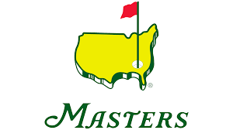

Business problem
The Masters aimed to create an immersive and personalized experience for fans while maintaining the tournament's history and tradition. They needed to adapt and evolve, especially during the pandemic, to deliver a seamless digital experience and overcome technical challenges.
Solution
IBM collaborated with the Masters, leveraging open hybrid cloud technology and AI to enhance fan engagement.
The Masters app's "My Group" feature allowed fans to track every swing, player, and hole in real time.
IBM analyzed 20,000 videos and 16 AI models provided personalized content about popular golfers, showcasing the potential of capturing and managing data across hybrid cloud environments.
How did IBM help enhance the Masters tournament experience with innovative technology?
IBM Automation / © IBM Corporation 2023
Notes:
Business problem: The Masters needed to create an immersive digital experience for fans while maintaining tradition and overcoming technical challenges during the pandemic.
Solution: IBM collaborated with The Masters, using open hybrid cloud technology and AI to enhance fan engagement. The Masters app's "My Group" feature allowed real-time tracking, while analyzing 20,000 videos and 16 AI models provided personalized content about popular golfers, showcasing data management capabilities across hybrid cloud environments.

Slide 15

Streamline incident management and increase uptime today!
IBM Cloud Pak for AIOps
Visit the product page
Read the Gartner report
Explore the product
Notes:
CTAs:
Cloud Pak for AIOps product page
Gartner AIOps Market Guide
Cloud Pak for AIOps product tour

Slide 16
IBM leads the market in Automation with AI
Gartner
IBM ranking: Leader
Magic Quadrant for Application Performance Monitoring and Observability
Gartner Magic Quadrant for Application Performance Monitoring and Observability, 2022
IBM ranking:
Representative Vendor
Gartner Market Guide for AIOps Platforms Enabling Continuous Insights Across IT Operations Monitoring
Gartner Market Guide for AIOps Platforms, 2022
IBM ranking: Leader
Magic Quadrant for Full Life Cycle API Management
Gartner Magic Quadrant for API Mgmt., 2022
IBM ranking:
Representative Vendor
Gartner Market Guide for Process Mining
Gartner Market Guide for Process Mining, 2021
Forrester
IBM ranking: Leader
API Management Solutions
The Forrester Wave: API Management Solutions, Q3 2022
IBM ranking: Leader
Digital Process Automation
The Forrester Wave: Digital Process Automation Software, Q4 2021
IBM ranking: Strong performer
Enterprise iPaaS
The Forrester Wave: Enterprise iPaaS, Q4 2021
IBM ranking: Strong performer
Content Services
The Forrester Wave: Content Platforms, Q2 2021
Omdia
IBM ranking: Leader
AIOps
Omdia Universe: Selecting an AIOps Solution, 2021-22
IBM ranking: Top Score
Critical Capabilities for Full Life Cycle API Management
Gartner Critical Capabilities for Full Life Cycle API Mgmt., 2022
G2
IBM ranking: Leader
Application Performance Monitoring
G2 Grid APM Tools, Fall 2022
IBM ranking: High Performer
Robotic Process Automation
G2 Grid Robotic Process Automation, 2022
EMA
IBM ranking: Top 3
Observability Platforms
EMA Top 3 Enterprise Decision Guide 2021
IBM ranking: Value Leader
Workload Automation
EMA Radar Report for Workload Automation, Q4 2021
IBM Automation / © 2023 IBM Corporation
16
Notes:
Our software is recognized as a leader by third party analysts group. We are consistently recognized as leaders across different features and capabilities of the portfolio.
Gartner:
Magic Quadrant for Intelligent Business Process Management Suites: https://www.gartner.com/doc/reprints?id=1-5PYMRPU&ct=181105&st=sb
Magic Quadrant for Full Life Cycle API Management: https://www.gartner.com/doc/reprints?id=1-27KLUA57&ct=211001&st=sb
Critical Capabilities for Enterprise Integration Platform as a Service https://www.gartner.com/reprints/?id=1-27RRXTKZ&ct=211029&st=sb
Critical Capabilities for Full Life Cycle API Management: https://www.gartner.com/reprints/?id=1-27OPGC7B&ct=211019&st=sb
Omdia:
Omdia Universe: Selecting a Content Services Platform Solution, 2021: https://www.ibm.com/account/reg/us-en/signup?formid=urx-50656
Infosource (acquired HSA in 2019):
HSA Capture Market Matrix (2019): https://www.ibm.com/downloads/cas/WRKMAKM2 (IBM-only link)
Nelson Hall:
Process Discovery & Mining Vendor Evaluation & Assessment tool: https://www.ibm.com/account/reg/us-en/signup?formid=urx-51346
IDC
IDC Market Analysis Perspective: Worldwide Analytics and Intelligent Automation Services, 2021: https://www.idc.com/getdoc.jsp?containerId=US47133121 (IBM-only)
IDC MarketScape: Worldwide SaaS and Cloud-Enabled Content Applications 2019 Vendor Assessment: http://idcdocserv.com/US44752819e_IBM
IDC MarketScape Worldwide Robotic Process Automation Software Vendor Assessment, 2020-2021: https://www.idc.com/getdoc.jsp?containerId=US45922220 (IBM-only)
Forrester:
The Forrester Wave™: Software For Digital Process Automation For Deep Deployments, Q2 2019: https://reprints.forrester.com/#/assets/2/73/RES144414/reports
The Forrester Wave™: Digital Decisioning Platforms, Q4 2020: https://www.ibm.com/account/reg/us-en/signup?formid=urx-48882
The Forrester Wave™: Content Platforms, Q2 2021: https://www.ibm.com/account/reg/signup?formid=urx-50797
Everest Group:
Intelligent Automation in Business Processes (IABP) – Solution Provider Landscape with Solutions PEAK Matrix® Assessment 2020: https://www2.everestgrp.com/reportaction/EGR-2020-38-R-3586/Toc
Robotic Process Automation Peak Matrix Assessment 2021: https://www2.everestgrp.com/reportaction/EGR-2021-38-R-4655/Toc (IBM-only)

Slide 17



IBM Automation expertise across industries
Global capabilities
Broad experience
Deep expertise
>17,000
Automation practitioners
>5,000
Automation clients
>15
Industry and domain heatmaps
3,000
IBM Research staff in 19 locations across six continents
3,800
Bots, runtime scripts and automata deployed
8,682
U.S. Patents in 2021, marking the 29th consecutive year of U.S. patent leadership
IBM Business Automation / © 2023 IBM Corporation
17
Notes:
With over 5,000 automation clients and deep industry expertise, IBM can provide guidance and best practices to get clients to results, fast.

